Slide 1

Lithium mining in Australia for electric cars and renewable energy
Group 3: Ziyang Chen, Gongcheng Zheng, Han Zhang, Hao Fu, Zixuan Gan
Australian National University
13/05/2021

Slide 2
Importance of Lithium
Medical Science
Treatment of mania
Military
Nuclear bomb
Renewable Energy (our research)
Lithium battery (High energy density)
It can be used in many aspects (laptop, electric cars, phone and so on)

Slide 3
Lithium Mining in Australia
52.9%
(1st)
18.1%
(2nd)
Lithium Production
Lithium Reserves

Slide 4
Context of Project
Engineering discussion on renewable energy for lithium mining project in Australia.
Context
Environmental Challenges
Ethical Challenges
Stakeholders
Social Challenges

Slide 5
Stakeholders Mapping
Local
Client
Mining Companies
Import
(China….)
Financial institutions
Bank
Lithium Mining
Suppliers
Ningbo Shanshan
Environment protection organization
Workers
Employment
Technical personnel

Slide 6
Different Systems Involved
Import
Transportation
Technology
And
Education
Universities 'course
lithium
Lithium Mining
worker
Employment
Economy
Increase GDP
Technical personnel

Slide 7
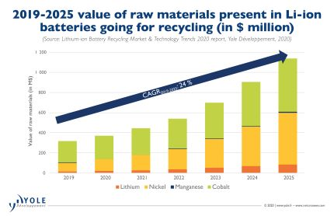
Environmental Effects
In extraction
Shortage in water
two million liters of water = one tone of lithium
Pollution after mining
large evaporation pools used for more than one year will leak toxic chemicals in water
This influence will also cause social unrest
In products
Recycling level for Lithium batteries is low
In Australia, two percent of the country’s 3,300 metric tons of lithium-ion waste is recycled
Different from the rising lithium production market, the recycling market for lithium batteries seems not impressive

Slide 8
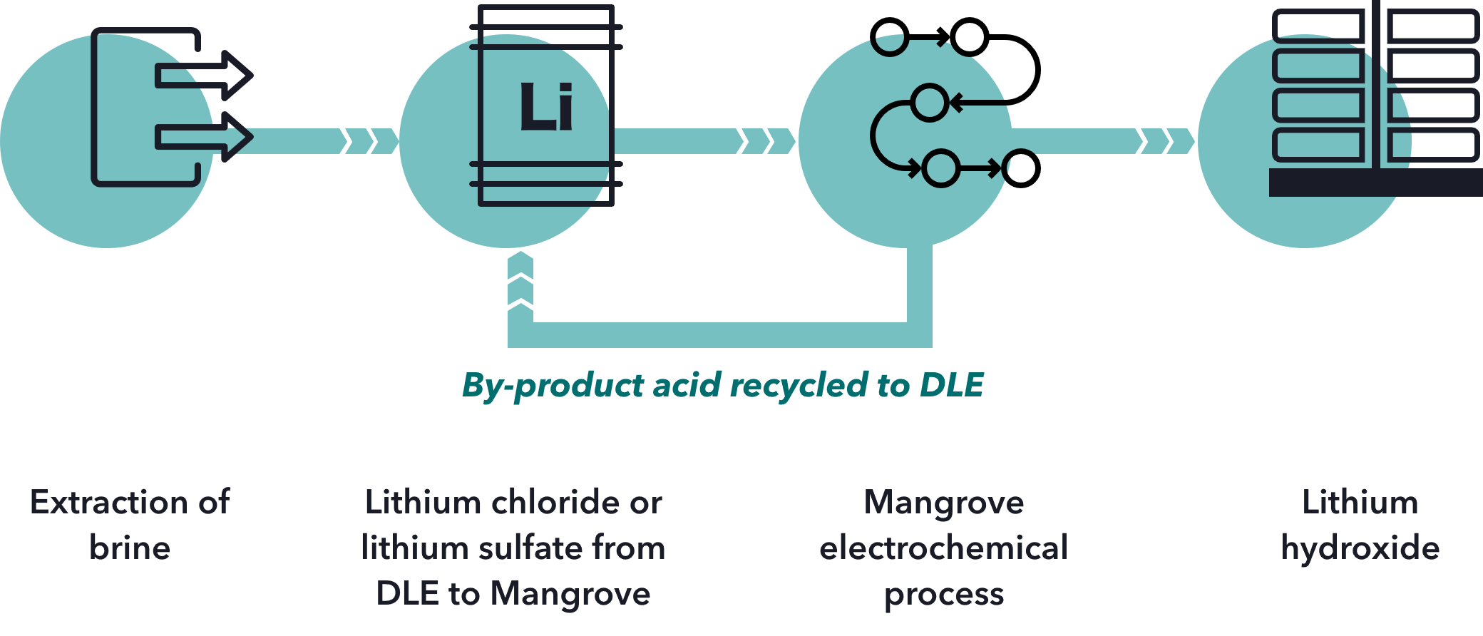
Environmental Effects: what can we do for the environment
Sustainable extraction
Direct Lithium Extraction (DLE)
Extract Lithium in geothermal water and selectively removing compounds from the water
Reduce the carbon footprint and water waste

Slide 9
Social Challenges
land-ownership
Is the original owner willing to move?
Can the owner get adequate compensation?
Social challenges caused by environment problem
Is industrial pollution harmful to people's health?
Will the original inhabitants be forced to relocate?

Slide 10
Social Challenges
Labor positions
The demand for labor varies in different periods
Disappointment for fewer jobs than expected
Economic impacts
Overly dependent on the mining industry
Income distribution

Slide 11
Social Challenges: what can we do?
Government
Formulate policies and improve laws
Balance the interests of enterprises and residents
Supervise
Mining companies
Consider labor interests in advance
Inform the public
Trade unions, media…

Slide 12

Ethical Challenges
Non-compromise approach to air quality
Dust suppression
Safer industry standards
Inevitably harm the soil and cause air contamination in Argentina

Slide 13
References
https://www.shangyexinzhi.com/article/362590.html
Liu, W., Eakin, H., Romero, H. (2018). Socio-environmental impacts of lithium mineral extraction: towards a research agenda
Schuler, D., Dolega, P., Degreif, S. (2018) Social, economic and environmental challenges in primary lithium and cobalt sourcing for the rapidly increasing electric mobility sector
Schuler, D., Brunn, C., Gsell, M., Manhart, A. (2016) Outlining Socio-Economic Challenges in the Non-Fuel Mining Sector
https://globalroadtechnology.com/lithium-mining-australia-history-top-locations-companies/#:~:text=Lithium%20mining%20in%20Australia%20occurs%20largely%20in%20the,batteries%20have%20become%20lithium’s%20major%20area%20of%20use
https://www.wired.co.uk/article/lithium-batteries-environment-impact
https://www.forbes.com/sites/jamesellsmoor/2019/06/10/electric-vehicles-are-driving-demand-for-lithium-with-environmental-consequences/?sh=56364d2062e2

Slide 14
Q&A

